Slide 1
League of Legend Victory Model

Slide 2
League of Legends Background
A massive online battle arena(moba) game that is extremely popular and is continually growing
We want to determine how to find the most significant factors into winning a game in league.
Also look at data from esport matches to see if we can predict the top 4 teams of Worlds
There is about 80 million monthly players of League of Legend.

Slide 3
League of Legend Esports
The esport marketing is booming which makes it valuable to research into it.
Getting better for esports can increase chance of winning a tournament which can have big payouts.
Being able to predict match victory before the game is over can improve lol players and esports team.

Slide 4
Data Gathering
Use two different data sets to gather some ideas on victories and esport teams
One set of data is gather from gol.gg which was all the teams from season 4,6,7, and 8. Then I added a top 4 column to represent which teams made it. It`s about 450 rows with 20 columns.I had to clean up missing data by deleting rows with 3 or more missing data and fill the rest with the average of the column.
The second set of data was gather from kaggle which was ranked league of legend data that contain about 10,000 rows and It has about 40 columns of feature.

Slide 5
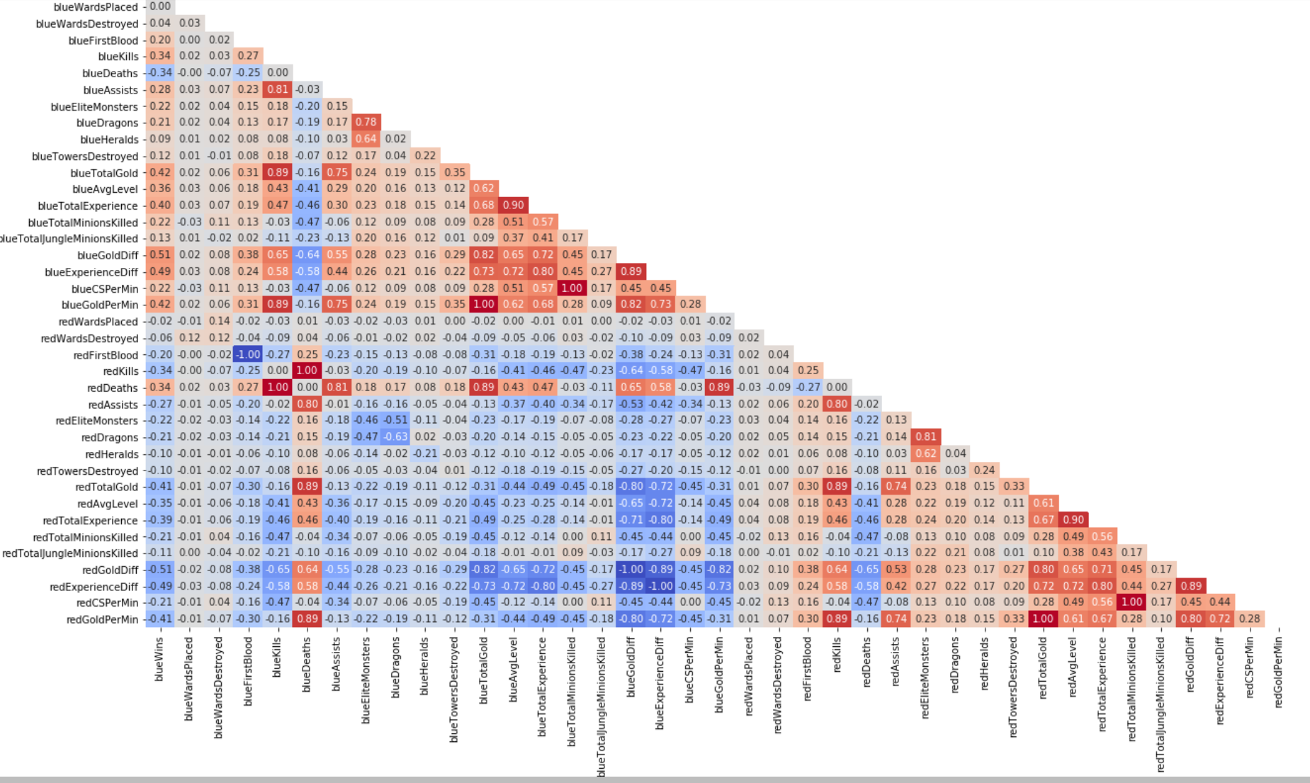
Correlation Between Blue wins
This is a graph showing all correlation between every feature available.
The darker the red, the more positive correlation it has and vice versa for blue with negative correlation.
Judging from this graph, you can see quite a bit of positive and negative correlation between features which will be helpful to create a model with.

Slide 6
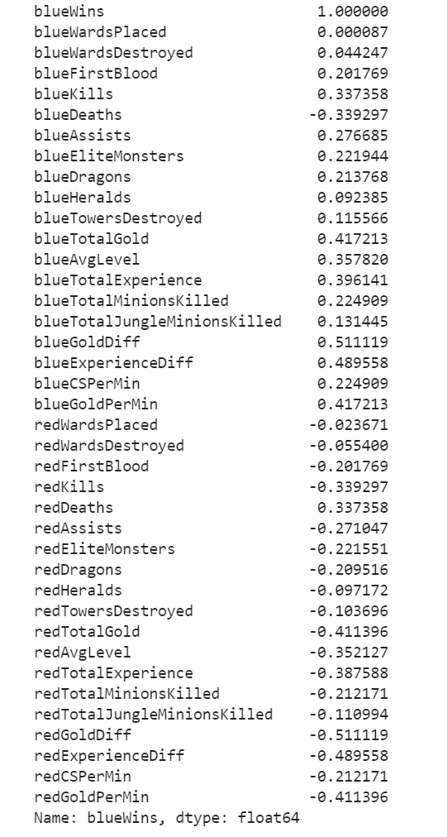
Correlation between Blue wins
This shows Features that impact the chances of Blue team to win
The most important feature is the Gold difference against the opposing team. The more gold difference that favors the blue team, the better the chance to win.
The second important feature is the experience difference between the teams with it having the same relationship with wins like gold
We can say that Gold and Experience are the most important aspect to victory

Slide 7
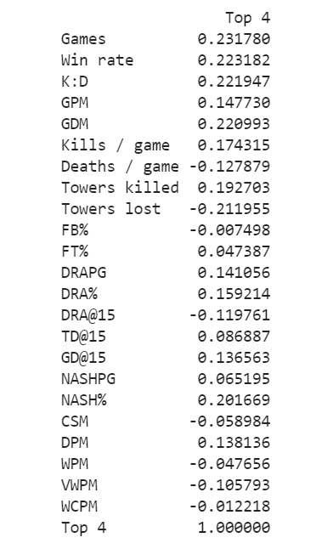
Correlation for Top 4
This shows that some of these features have a impacted of the top 4 but it isn't decisive enough. I won`t be including Games since I can`t used that in my model.
The top 3 decisive factors are Win rate, Kill/Death ratio and Gold Difference per minute.
What is interesting is that in both models you notice that gold is playing a important factor in winning.

Slide 8
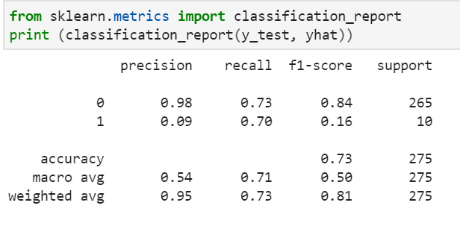
Esport Model Logistic Regression
What this shows is that the model is inaccurate in predicting the top 4.
Even though the f1-score average is good,It does not mean it is a good model.
The reason f1-score is high is because the default answer is 0

Slide 9
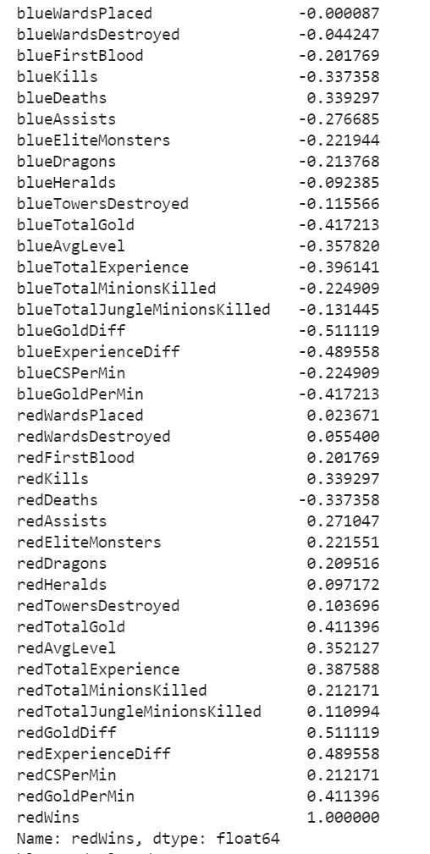
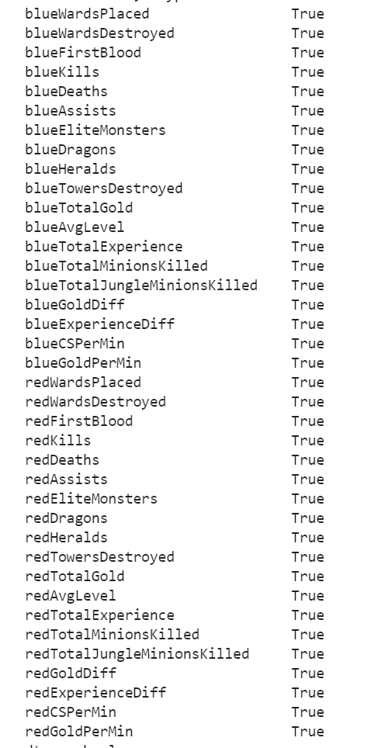
Correlation Between Red Win
These are the result of the correlation between red wins and features but also if the correlation are the same for the red and blue team.
The same features that were important in the blue team win is the same as the red team win.
I decide to inverse of the red team correlation and compare it to the blue team correlation
What I see is that the blue and red team correlation are exactly opposite of each other which means the win condition is exactly the same for both teams

Slide 10
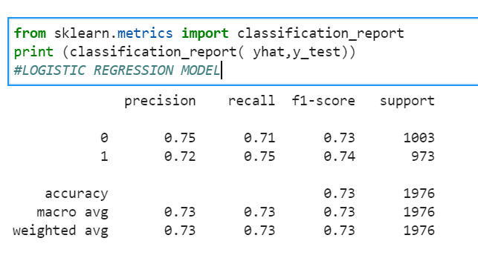
Ranked Data Model Logistic Regression
This is how well the logistic regression model perform on the ranked data.
This model was on a 50/50 test/train split.
The f1 score of the model is good for both prediction which is a good indicator that the model is pretty accurate.

Slide 11
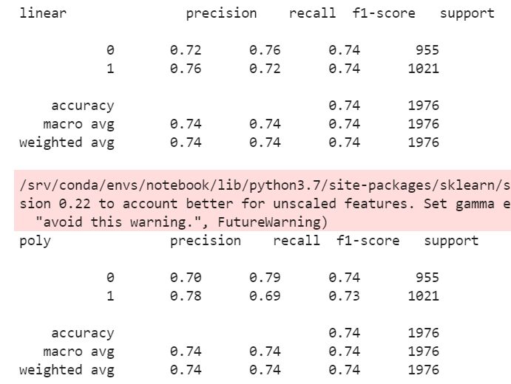
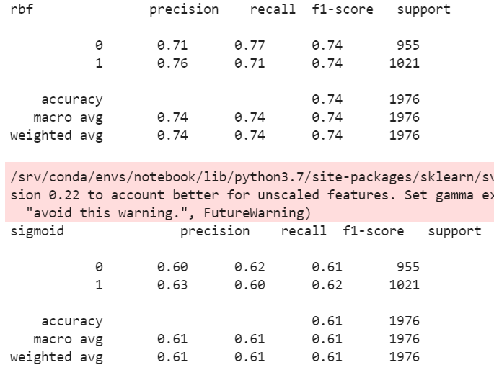
Ranked Data Model SVM
These models were also train on the same 50/50 split.
Most of the SVM Did well beside the sigmoid keneral.
The SVM perform slightly better than the logistic regression model if the SVM keneral is Linear or RBF

Slide 12
Conclusion
I was able to make a good model to predict a red/blue team victory based on the first 10 minutes of the game.
There wasn't enough data to make a efficient model to predict a esport team of being in the top 4.
The Win condition for the red team and the blue team are exactly the same which is a good result.
Lastly Both models have a good baseline and have potential to grow into something very useful in the future.

